Slide 1
Qualitative Methods in Psychology: Development and Integration
Frederick J. Wertz
Fordham University
American Psychological Association Annual Convention 2019
Chicago, Illinois
August 10, 2019

Slide 2
Outline
A little background
History and Importance of Qualitative Research
Pioneers
Flanagan
“Revolution”
Fundamental significance and utility
Epistemic Value
Social Value
Phenomenology: An invaluable resource
Phenomenological Psychological Reduction
Eidetic Analysis
Giorgi
Comparative Methodology
Duquesne Dissertations
Victimization study
Existential phenomenology
Psychoanalysis
5 approaches to qualitative analysis
Students’ work: The next generation
Indigenous methods

Slide 3
45+ Years
Undergraduate: Beloit College. Statistics teaching assistant, qualitative research on experience of time, phenomenology w/ Profs. Goldman & Summers
Graduate: Duquesne University. Giorgi’s research and teaching assistant, philosophy, NIH study of crime victimization, qualitative analytic procedures, perception dissertation directed by Giorgi
Faculty: Fordham University. Empirical investigations, common analytic procedures in existential and psychoanalytic psychology; history of qualitative methods; phenomenological reductions; comparative qualitative methodology; relations of quantitative and qualitative, and mixed methods; problem solving with students—clinical, developmental, & quantitative-psychometric; indigenous methods

Slide 4
Science: Epistemic and Social Values
Science: Wedding of rationality and observation for responsible shaping of destiny
Empiricism (original, broad sense)
Conceptual precision (quantitative and qualitative reasoning)
Telos: Ethical—Responsible practice in the social and natural world (Husserl)
Rise & Development of natural science and technology
Knowledge of material world
Development of measurement and quantitative analysis
Emphasis: quantitative reasoning, neglect of qualitative reasoning
Critical Science Studies: Kuhn and beyond
Contemporary methodological pluralism

Slide 5
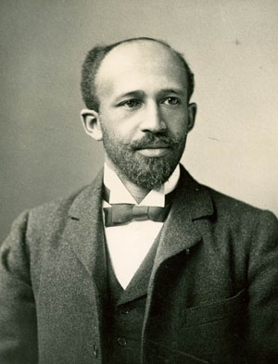
“The sole aim of any society
is to settle its problems
in accordance with its highest ideals,
and the only rational method
of accomplishing this
is to study those problems
in light of the best scientific research.”
W.E.B. Du Bois, (1868-1963)
Du Bois, W.E.B. (1898). The study of Negro problems. Annals of the American Academy of Political and Social Science.

Slide 6
History and Development of Qualitative Methods in Psychology
Philosophy
Psychology
Positivism as universal science
Late 19th century philosophical recognition of need for alternative or supplemental methods
Phenomenological method
Psychology as fundamental empirical science
Specification of method
Phenomenological psychological reduction
Eidetic analysis
Rise of continental philosophy
Generative psychological research (by philosophers)
Formal development of research methodology: Focus on measurement and quantitative analysis, reasoning
Practice of qualitative research without formal methodology (pre-1960).
Call for qualitative methodologies: 1940s
Development of methodologies: 1960s-90s
Growth of applications, journals, education, conferences: Starting 1980s
Qualitative Revolution: 1995-present
Methodological pluralism

Slide 7
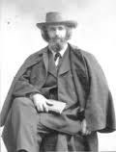
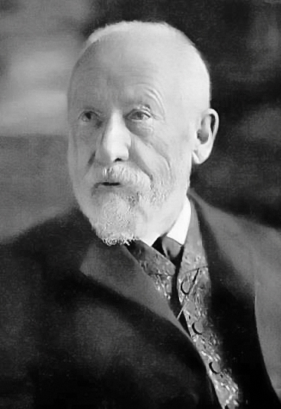
Philosophy of the Human Science Tradition
Franz Brentano
(1838-1917)
Consciousness differs from physical things
Intentionality of consciousness
Psychology as a science of experience
Wilhelm Dilthey
(1833-1911)
Naturwissenshaften differ from Geisteswissenshaften (Verstehen)
“We explain nature; we understand experience”
Knowing causality versus meaning

Slide 8
Practice in Psychology: Methods without Methodology
Wilhelm Wundt Kurt Levin
Sigmund Freud John Dollard
William James Lawrence Kohlberg
Jean Piaget Leon Festinger
Frederic Bartlett Irving Janis
John B. Watson Philip Zimbardo
Edward B. Titchener Herbert Simon
Abraham Maslow Daniel Kahneman

Slide 9
Wilhelm Wundt (1832-1920) Völkerpsychologie (10 volumes, 1900-1920)

Slide 10
William James (1842-1910) Varieties of Religious Experience (1900)

Slide 11
Sigmund Freud (1856-1939) Psychopathology, Dreams, Parapraxes, Jokes, Creative Works

Slide 12
Jean Piaget (1896-1980) Cognitive Development, 1958

Slide 13
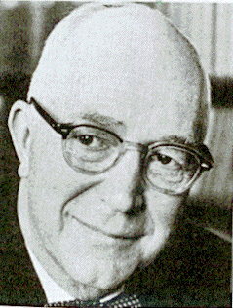
Gordon Allport called for
“bold and radical experimentation”
in Use of Personal Documents in Psychological Science, National Research Council
“Strong counter-measures are indicated against theorists who damn the personal document with faint praise, saying that its sole merit lies in its capacity to yield hunches or to suggest hypotheses…they fail to express more than a small part of the value of personal documents for social science” (Allport, 1942, p. 191).

Slide 14
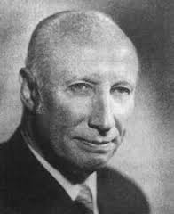
John C. Flanagan (1906-1996) Critical Incident Technique

Slide 15
Career Timeline
1941: Joined Army Air Forces as Major, promoted to Colonel
Director, Aviation Psychology Program, WWII: Selection of flight crews 150 psychologists and 1500 research assistants
Studies of effective military actions, e.g., flight training and combat leadership
1946: Critical Incident Technique (CIT) spelled out in military document
Professor, University of Pittsburgh: studies of effective teaching, dentistry, nursing, business, and government
Founded American Institutes for Research (AIR), 1946
1948: Edited The Aviation Psychology Program in the Army Air Forces: Report #1 (19 volumes)
1951: President of Psychometric Society
1954: Critical Incident Technique published in Psychological Review
President, 4 APA Divisions: Evaluation, Measurement & Statistics (5) 1956
5 psychologists working under Flanagan later became APA presidents, 11 served on APA Board of Directors

Slide 16
Critical Incident Technique (CIT)
WWII Aviation Psychology Program, USAF
Limits of questionnaires and expert opinions
Virtues of concrete incidents of success and failure
Importance of extreme examples
Inductive analysis
Applications in health care, education, psychology, business, APA ethics code

Slide 17
5 Steps of CIT
Determining aims
Making plans and setting specifications
Data collection
Data analysis
- determining frame of reference
- forming categories by inductive reasoning
- determining level of generality for report
5. Interpretation and reporting

Slide 18
American Institutes for Research
Objective: “… to contribute to the science of human behavior and the fuller development and utilization of mankind’s capacities and potential.”
1950s-1960s--Provided data for selection of pilots, co-pilots, and flight engineers for commercial airlines for over 20 years
1959— For the National Board of Medical Examiners improved the validity of the licensing examination for Physicians by observing actual behavior in hospitals and collecting several thousand incidents of effective and ineffective medical performance, defining competence, and constructing new test. National board still uses this model for Part III
1960s—In decolonized Africa, given lack of educated persons to meet independent nation’s needs, AIR implemented program in 19 developing countries identifying individuals with potential for vocational training and advanced degrees.
1960—Project TALENT surveyed 400,000 high school students to assess educational needs.
1960s—Project PLAN (Program for Learning in Accordance with Needs) constructed first individualized computer-assisted learning program for complete curriculum for grades 1-12.
AIR used CIT to develop a quality of life scale that is still used today

Slide 19
Quality of Life 16 Factors Based on CIT
Physical and material well being
Health and personal safety
Relations with family
Relations with close friends
Relations with other gender
Participation in social, community and civic activities
Intellectual activities
Aesthetic appreciation
Spiritual development
Developing skills and manual activities
Understanding and appreciating oneself
Occupational position
Creativity
Social recreation
Spectator recreation
Active recreation
Cf. Maslow’s “need hierarchy”

Slide 20
Recent Innovations
Redefinitions and extentions
From ‘critical’ to ‘significant,’ ‘revelatory,’ ‘emotional,’ ‘self-interpreted’
From ‘incident’ to ‘experience,’ ‘episode,’ ‘transitional period’
Credibility checks and enhancements (ECIT): context inclusion, interview guides, independent analyses, category participation rates, participant verification, expert opinions, theoretical agreement, detailing procedures
Broadening scope from predetermined outcomes to personal growth, challenging assumptions, value transformation
Expanded data collection involving journals, portfolios, autobiographical narratives
Use of phenomenological and narrative analytic methods

Slide 21
Bibliography Database Critical Incident Technique American Psychological Association Website Donated by Grace Fivars & Robert Fitzpatrick American Institutes for Research
50 Years of research: Articles, Reports, books, professional papers, dissertations
Over 300 pages
Over 3000 references
Updates implemented by American Psychological Association

Slide 22
Development of APA Ethics Code
1947 Committee on Ethical Standards for Psychologists, chair Edward Tolman
Choice of CIT as procedure
APA members describe ethical actions, situations, and issues
Second committee, chaired by Nicholas Hobbs, solicits 1000 ethical incidents
Code based on incidents adopted in 1952
Critical incidents of ethical challenge and actions used in subsequent revisions of code through 1992 and 2002

Slide 23
Archives of the History of American Psychology
Cummings Center for the History of Psychology
University of Akron

Slide 26
Quality of Life
Factors
w/ illustrative quotations
from CIT data

Slide 27
The Qualitative “Revolution”
Sociology, anthropology, history, and humanities 1970-1990
Psychology a late comer—mid 1990s
Philosophical (epistemological, ontological) and scientific rationales not the driving force
Politically sensitive social and practical problems drive revolution
Marginalized ethnicities in sociology
3rd and 4th world peoples in anthropology
Feminism
Practice areas: Counseling, education, nursing, social service
Humanistic psychology: Human science methods based on phenomenology and existentialism (Giorgi), grounded theory (Rennie), and consensual qualitative research (Hill) but limited to counseling research

Slide 28
Spread of Qualitative Methods
(1990-present)
Social Psychology (Marecek, Fine, and Kidder, 1997)
Industrial-Organizational Psychology (Cassell and Symon, 2006)
Counseling Psychology (Hoyt and Bhati, 2007)
Educational Psychology (Chase and Villella, 2004)
School Psychology (Michell, 2004)
Clinical Child Psychology (Krahn, Holn, Kime,1995)
Health Psychology (Dickson-Swift, et al, 2007; Yardley, 2000)
Cultural and Multicultural Psychology (Ratner, 2008; Ponterotto, 2002)
Evaluation Psychology (Mark, 2002)
Sport Psychology (Weinberg and Gould, 2009)
Professional Psychology (Goldman, 1993)
Health Care Systems (Hodges, Hernandez, Pinto, Uzzell, 2007)

Slide 29
Contemporary Methodological Pluralism
Post-Positivist
Existential
Pragmatic
Narrative
Cultural/community based
Mixed methods
Interdisciplinarity and breakdown of boundaries
Professional integrations
Sciences
Science, humanities, and arts
Multi-media

Slide 30
Two Kinds of Scientific Reasoning Quantitative is Founded on Qualitative
Quantitative reasoning/analysis—Magnitude: How much/many?
Qualitative reasoning/analysis--Being: What?
Quantification requires quality: No measurement without something measured
What is measured?
Quantity is itself a quality: Amount is a “what,” a meaningful being
“Clinical significance”
Psychological significance

Slide 31
Construct Clarification: To what do our terms and measurements refer?

Slide 32
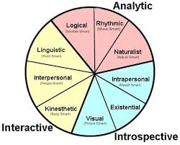
Intelligence

Slide 33
Edmund Husserl (1959-1938) Mathematician, Philosopher Phenomenology: Universal Rigorous Science (including lived experience)

Slide 34
Husserl’s Legacy
Publications introducing phenomenology as a method for philosophy and mental sciences
45,000 pages of unpublished, untranslated manuscripts
Analyses of body, time, intersubjectivity, passivity, alterity, ethics, practical life, genesis, generativity, history
Not taught in Germany during Nazi era (1933-1945)
Few doctoral dissertations until the 1960s
Publications slowly emerging since the 1960s
Past criticisms unfounded: failed to take writings and discontinuous movements into account
Unity of entire movement anticipated in Husserl’s work

Slide 35
Trans-Disciplinary Movement
Archaeology, Architecture, Art History, Cognitive Science, Communicology, Counseling, Cultural Anthropology, Dance, Ecology, Economics, Education, English, Ethnic Studies, Ethnology, Ethnomethodology, Film Studies, French, Gender Studies, Geography, Hermeneutics, History, Linguistics, Law, Literature, Medical Anthropology, Medicine, Musicology, Neuroscience, Nursing, Religious Studies, Philosophy, Political Science, Psychiatry, Psychology, Psychopathology, Religious Education, Social Work, Sociology, Sport, and Theology (based on Embree, 2010)

Slide 36
Trans-National Movement
Argentina, Australia, Austria, Belarus, Belgium, Brazil, Bulgaria, Canada, Chile, China, Colombia, Croatia, Czech Republic, Denmark, Finland, France, Germany, Greece, Hong Kong, Hungary, Iceland, India, Indonesia, Iran, Ireland, Israel, Italy, Japan, Korea, Latvia, Lebanon, Lithuania, Malta, Mexico, Netherlands. New Zeeland, Norway, Peru, Poland, Portugal, Romania, Russia, Serbia, Slovenia, South Africa, Spain, Switzerland, Taiwan, Tunisia, Turkey, United Kingdom, United States of America, and Venezuela. (Embree, 2010)

Slide 37
Phenomenological Method Basics
Concrete example(s) of subject matter under investigation
Phenomenological psychological focus (“reduction” (to pure animate experience)
Setting aside theory, previous research, preconceptions
Setting aside the objective and material world apart from experience
Focusing on intentional processes and objects (psychological)
Eidetic analysis (of invariance, “essence”--the ”what”)
Multiple examples from others and self
Free imaginative variation
Universal law
Natural language description of structure(s): Ideographic and nomothetic levels of generality

Slide 38
Phenomenological Movement Contemporary Psychology
Philosophical clarifications for human science
Theoretical grounding, critique, and unification
Research methodology
1) Phenomenological method development (e.g., Giorgi, 2009)
2) Critique of diverse methods (e.g., neo-positivist, grounded theory, discourse analysis, narrative)
3) Mixed method synthesis
Positive research programs
1) Original studies
2) Meta-analytic studies
Trans-disciplinary Collaboration and Interdisciplinary inquiry

Slide 39
Amedeo Giorgi Methods for Human Science Research

Slide 40
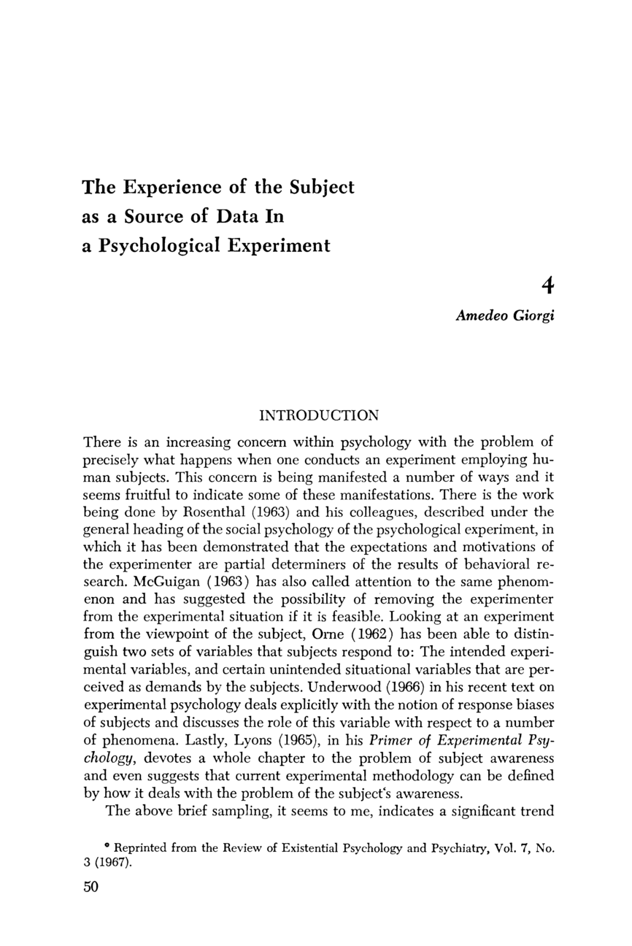
Amedeo Giorgi (1967): Experimentation with Qualitative Analysis

Slide 41
Giorgi’s Specification of Analytic Procedures
Attitude:
- Suspend prior knowledge of topic
- Suspend concerns about reality independent of experience
- Phenomenological reduction (focus on experience, intentionality)
- Eidetic Reduction (focus on essence, eidetic analysis)
Protocol Analysis--Procedures:
1. Open Reading
2. Demarcation of meaning units
3. Psychological Reflection on each meaning unit
4. Synthesis: Description of structure(s): Ideographic and nomothetic

Slide 42
Comparative Methodology Common Analytic Procedures
Duquesne University doctoral dissertations (~100)
Criminal Victimization study (Reflection in depth and detail)
Existential phenomenological psychology literature
Psychoanalysis
History of qualitative research (before formal methods)
Contemporary pluralism

Slide 43
Comparison of 5 Analytic Methods
Phenomenology
(me)
Grounded Theory
(Kathy Charmaz)
Discourse Analysis
(Linda McMullen)
Narrative Research
(Ruthellen Josselson)
Intuitive Inquiry
(Rosemarie Anderson)

Slide 44
Common Fundaments of Qualitative Research
Reflexive account of presuppositions
Concrete examples—observations, descriptions
Critical assessment of data: context, limits, and appropriateness
Transparent account of procedures
Open, multiple readings
Language sensitivity to expression in context
Emergent ideation rooted textual data
Meaning explication—differentiation, articulation
Holistic account of structural organization
Analytic comparison of multiple examples
Evidence presented in support of knowledge claims
Emphasis on subjectivity: embodied, practical, affective, linguistic, social, cultural, and temporal
Self-critical reflexivity on limits of research

Slide 45
Distinctive Features of Qualitative Traditions
Phenomenological Psychology
Epochés (abstention from natural science, theory, and existential positing)
Intentional analysis of structures of lifeworld
Imaginative variation in eidetic analysis to clarify qualitative generalities
Grounded Theory
Mid-level theory building and testing (abductive reasoning)
Theoretical sampling of data
Bridging with traditional hypothetical science
Discourse Analysis
Reinterprets traditional concepts as discursive practices
Radical focus on language, including social contexts and consequences
Special tools of and procedures for linguistic analysis
Narrative Research
Engages diverse disciplinary, theoretical, and social positions
Organizing and meaning-making functions of story telling
Use of literary conventions of analysis
Participatory Action Research
Practical, emancipatory aim
Partnership with participants in all phases of research
Critical theory

Slide 46
Qualitative Clarification of
Quantitatively Based Knowledge
Comparative Research on
Clinical and Sub-Clinical Bulimia (BN)
Niki Skoufalos
Clinical Psychology
Fordham University

Slide 47
Problems and Research Question
The diagnostic criteria for bulimia nervosa has changed changed continually over history
Research shows that similar factors are correlated with binging and purging at clinical (diagnosable) and sub-clinical (insufficient to meet current diagnostic criteria) levels.
Debate over arbitrariness of diagnostic criteria.
Concern that sub-clinical bulimic population is at risk for developing clinical bulimia and needs psychological services
What is the psychology of these two populations: are they qualitatively similar or different?

Slide 48
Methods
Recruitment & Selection
From 322 undergraduates,
4 clinical BN and 10 SCBN, 6 nonBN
Instruments
Demographics Form
Revised Restraint Scale (RS; Polivy & Herman, 1985)
EDI-3 (Garner, 2006)
Personal Style Inventory-II (PSI-II; Robins et al., 1994)
Dissociative Experiences Scale-II (DES-II; Bernstein & Putnam, 1986)
State-Trait Anger Expression Scale-2 (STAXI-2; Spielberger, 1999)
Good Experiences Questionnaire (GEQ)
SCID-I/NP (First et. al., 2002)
Interview/Focus Group Guide
Data Analysis
Psychological phenomenological analysis (Giorgi, 1985)
6 Individual analyses and structures, 4 Modified Analyses
Comparative analyses of 20 individuals and 3 focus groups --3 General structures
Search for confirmation and disconfirmation in all data

Slide 49
General Psychological Structure 1: Clinical BN
Voracious adult appetite and love of food
Loneliness and isolation in face of consistent abandonment, neglect, and rejection
Persistently failing attempts to solicit care, help, affection, and belonging
Detachment and angry blaming of self and others
Adolescence: Pervasive emptiness and risk of fading into social obscurity
Body dissatisfaction as part of overall sense of unworthiness
Influence of the media/Ideal of thinness
Observational learning of the binge and purge
Binging as self care and purging in hope of attracting others
Secret effective comfort and desirability through binging and purging: Hope for emotional change

Slide 50
General Psychological Structure 2: Sub-Clinical BN
Intermittent experiences of abuse, neglect, rejection
Learning to suppress anger at risk of loss or counter-attack
Forming a protective, gratifying alliance with family member against abusive/rejecting parent and others
Appropriating the standards/values/ideals of the ally for safety
Satisfaction, acceptance and belonging through efforts at perfection
Dieting fails at minimizing risk of rejection as body grows in adolescence
Binging as means to numb emotional disturbance and gain pleasure when facing interpersonal discord and rejection
Purging to prevent rejection and to achieve belonging through perfect (thin) body
Unexpressed desire to share emotional disturbance and anger with an accepting other

Slide 51
Clinical and Subclinical BN: Continuity & Discontinuity
Continuity
Spontaneous Enjoyment of Food
Observation of Others Engaging in Binge-Purge Behaviors
Use of Binge to Provide Soothing Comfort
Desire to be Accepted
Difficulty Expressing Emotions Perceived as Unwelcome
Discontinuity
Qualitative differences in meanings of eating patterns and structure of the life-development
The same etiological and associated factors hold various meanings that sharply contrast among the three participant groups

Slide 52
Qualitatively Based Measurement:
Catholic Institutional Identity
In Higher Education
Ann Higgins
Kathy Jankowski
Applied Developmental Psychology

Slide 53
Top Down-Bottom Up Method
Review of literature: education and theology
Interviews with administrators, faculty, students, and staff
Conceptual analysis
Phenomenological analysis
Identification of 6 essential constituents
Construction of preliminary instrument
300 Questions drawn from interviews
Reduction to 100 non-redundant questions

Slide 54
Institutional Culture: Six Constituents
Visible links to the Catholic Church
Charism
Curriculum
Behavioral norms
Personal formation
Multireligious culture

Slide 55
Multi-Religious Culture
Non-religious perspectives are respected on campus.
Students gain familiarity with their own religious tradition here.
Catholic students feel more at home here than non-Catholic students.
The availability of religious symbols and services from multiple faiths deepens student thinking.
Students engage in exercises or practices of their own faith on this campus.
Students of all religious backgrounds are welcome here.
Campus ministries are active.
There are only Catholic religious symbols on campus.
There is not much religious diversity on this campus.
Places of worship for various religious groups are available on campus.

Slide 56
Fordham University Climate Survey
Instructions
The following statements may describe aspects of university climate and life on campus.
For each statement, first, check the box that you think best applies to your university currently (Does Not Describe at All, Does Not Describe Well, Describes Partly, Describes Mostly, Describes Completely, or Don’t Know).
Second, rate how important this aspect is for you on a scale of 1-5, 1=Not Important and 5=Very Important.
There are no right or wrong answers.

Slide 57
Fordham University Climate Survey Sample Questions
Education at this university aims to develop leaders who strive to right social injustices.
Critical thinking is encouraged across the curriculum.
Catholic Mass is easily accessible on campus.
Students of all religious backgrounds are welcome here.
This university enhances a student’s ability to make difficult personal moral decisions.

Slide 58
Qualitative Understanding of
Quantitative Anomalies
Effectiveness of Reading & Math Programs
For Children Ages 3-8 in Inner City Schools
Kimber Bogard
Applied Developmental Psychology
Fordham University

Slide 59
Measures:
3 Urban Schools
Outcomes:
Reading Test Scores
Math Test Scores
Structural and Process variables:
Class size
Classroom student-adult ratios
Emotional climate of classroom
Teacher years of education
Teacher special training
Teacher sensitivity

Slide 60
Predictions Not Supported
Mostly non-significant relationships between educational variables and reading/math outcomes across schools
School as moderator of relationship between structure and process variables
In School L, teachers’ years of experience and specialized training correlated with instructional climate and student performance whereas in Schools M and Q, no relationship between teacher education and instructional climate or student performance
Schools M and Q were higher than School L on emotional and instructional climates
Number of adults in classroom and class size positively correlated with performance (against prediction)

Slide 61
Teaching in Silos (School L)
Monthly meetings to discuss curriculum and standards
Teachers drew on education for methods of implementation
Teachers reflected in isolation on how to solve problemsmeet standards
No interaction with teachers in same or other grades about common or unique activities
Variability in assignments, assessments, and supplementary curricular materials

Slide 62
Unidirectionally Coached Teaching (School Q)
Literary Coach selected by principal
Met with teachers at each grade
Described standards/goals
Provided tools of assessment
Provided tools for implementation developed by others
Standard received procedures at each gade level
Stable over time
No input from teachers

Slide 63
Dynamic Collective Improvisation (School M)
Principal is both a visionary leader with no set plan and practically provides the time and space for open discussion
Team-oriented meetings designed to air problems, find collective solutions to challenges
Working synergy among stakeholders
Ownership of the teaching curriculum and assessment
New insights lead to adjustment in methods

Slide 64
Anomalous Findings

Slide 65
Conclusions
No general quantitative relationships between isolated educational variables and student outcomes as predicted
Qualitatively determined holistic school organizations moderated and were related to both educational variables and student outcomes
School (M) with principal’s vision and leadership, teacher ownership of programs, collaborative teacher alliances within and between grade levels, and creative problem solving among diverse stakeholders had best educational environment and highest achievement outcomes despite largest class sizes and low teacher-student ratios.
School (Q) with special, shared coaching, materials, and tools had middle level performance and teacher education and years of experience, like school M, were unrelated to structural and outcome variables
School (L) with teachers isolated and left to their own devices to deal with challenges achieved lowest scores and outcomes varied with teachers’ educational level, specialized training, and years of experience

Slide 66
Mathematical Modeling
Integrating Qualitative Methods:
Graduate Student Adjustment
Arnond Sakworawich
Psychometrics
Fordham University

Slide 67
Objectives
To formulate a method for constructing a mathematical model from qualitative data.
To demonstrate the method
with a person-centered mathematical model
of student’s adjustment to graduate school.

Slide 68
Approaches to Mathematical Modeling
Empirical approach to quantitative data
Galileo –pulse and an pivoting pendulum in Pisa tower- Pendulum law
Psychophysics – Steven, S. S. (power law)
Curve fitting
Exploratory Data Analysis (John Tukey)
Finding patterns (of relationship) in data
Logical – mathematical derivation
Isaac Newton - Used calculus to develop a theory of modern mechanics and gravitational force
Classical test theory (Charles Spearman and others)
Item response theory (Lord & Novick)
Generalizability theory (Cronbach & Gleser)

Slide 69
Nobel Prize Winning Psychologists Mathematical Models from Qualitative Data
Herbert A. Simon
Think aloud protocols
Protocol Analysis
Artificial intelligence and expert systems theory
Daniel Kahneman
(& Amos Tversky, deceased)
Play gambling, Jerusalem afternoons
Described thinking, sought consensus
Derived prospect theory with mathematics

Slide 70
Data collection
14 graduate students wrote narrative descriptions
of their adjustment to graduate school
Examples the critical incidents of good versus bad adjustment
Students conducted in-depth follow up interviews on each narrative

Slide 71
Analysis Step 1: Open Reading
Read all descriptions and interview transcripts to get a sense of a whole data.
Bracketing myself
Follow, empathize, and understand lived through experiences

Slide 72
Analysis Step 2. Intentional analysis
Demarcate meaning units
Identify relevancy to adjustment to graduate school
Psychological reflection on each relevant meaning unit
Reflect on interrelation of personal meanings

Slide 73
Analysis Step 3: Open coding
Name conceptual categories (variables)
Break down into units of meanings and concepts
Underline important quotations, comments and take notes
Quotation: “She (mentor) was very erratic. Her mood was never predictable. Every day, I would come to work and ask her administrative assistant what kind of mood she was in.”
Categories: unpredictability, ambiguity, frustration-with mentor

Slide 74
Analysis Step 4: Grouping Concepts and Meanings
Aim
Simpler but powerful variables (to be parsimonious)
Procedures
Sort several concepts into piles by similarities
Organize piles into hierarchy of structures
Graphic representation using map
Verify results with method of constant comparison

Slide 75
Hierarchical Structure:
Discrepancy as Motivation to Adjustment
Level I
Discrepancy
Level II
Past status quo vs. current state
Self expectation vs. actual performance
Other vs. self
Other’s expectation vs. own performance
Level III
Weather
Classroom
Workload
Mentor
Classmate
Research
Language
Finance
Time management
Family - Lovers

Slide 76
Axial Coding
Explore the interrelationship between variables.
Find evidences for interrelationships among variables – sign and direction-
Iterative process
Support (-)→Suffering + Frustration --- Support mitigates suffering.
At the very least, they understood the difficulties I was enduring and we could commiserate about working for this particular professor and the hardships of graduate school together.
Diagramming
Path Diagram – Easy to be converted into systems of equations

Slide 77
Graphic Diagram for Adjustment to Graduate School
status quo vs. current state
Happiness-Unhappiness
Self expectation vs. actual performance
Importance*Negative Discrepancy
-
other vs. self actual performance
Interpretation
other’s expectation vs. own performance
Sense of efficacy
Sense of meaningfulness
Support
-
Mental Toughness
Ambiguity and unpredictability

Slide 78
Theory Construction Through Selective Coding and Eidetic Analysis
Conversion of diagram into equation
Create explanatory whole using free imaginative variation
One comprehensive structure that synchronizes all constituents of the model
Starting with concrete examples and then imaginatively varies it in every possible way to extract the essence or theory that can exhaustively reflect the whole phenomenon
Requires creativity
Verification with data
Use theory to make predictions and then validate with data
Requires analytical and critical thinking.
Loop until theoretical saturation

Slide 79
Mathematical Model of Adjustment to Graduate School
☺-☹
subscript i = i^{th} aspects of graduate student life
= Happiness—Unhappiness
IP_{i} is the InterPretation which composed of, a) sense of efficacy, b) sense of meaningfulness, c) perceived support, and d) mental toughness
ND_{i} is the Negative Discrepancy (Present is worse than the past or expectation) between a) Past status quo vs. current state, b) expectation vs. actual performance, c) other vs. self, and d) other’s expectation vs. own performance.
V_{i} is Value – importance or priority given to each aspect for negative discrepancy
A_{i} is Ambiguity and unpredictability
☺- ☹

Slide 80
How Does a Person Adjust?
Holistic approach to adjustment to graduate school (LHS)
Cope with Happiness-Unhappiness directly
Convert unhappiness into goal, challenge, or humor
Compensation
Freely transform those variables in the equation (RHS)
Change Value (V)
Close Negative Discrepancy (ND)
Learning and hardworking
Lower own expectation
Stop comparing
Compare to the right person
Make other to expect themselves to be closer to reality
Do nothing
Change Interpretation (IP) to be positive
Be tougher
Positive self talk – boost up sense of efficacy
Seek support from significant others—mentor, teachers peers
Cognitive reframing on meaning – search for meaning
Decrease ambiguity and unpredictability

Slide 81
Person-Centered Applications
Program Design
Graduate Student Orientation
Faculty-Student Interactive Meetings/ Workshops
Program Evaluation
Measurement
Assessment
Counseling
Individual
Group
Interventions Development

Slide 82
Mixed Methods Research
on Psychology
Discourse and Meanings
of Unity in Psychology
Charles Olbert
Clinical Psychology
Fordham University
w/ L. Osbeck, President, APA Division of General Psychology (1)

Slide 83
Data Collection
27 newsletter issues
Spring 1999 to Fall 2012
24 w/data (88/9%)
Explicit statements about general psychology
67 total articles/candidate statements

Slide 84
Data Coding
Passages read twice
1: assigned preliminary code words
2: recoded and transcribed
Multiple codes/passage
128 passages
81 preliminary codes
Cleaned database
Consolidation & correction
42 final codes

Slide 85
Example Passage
“[Division One should] bring people together...to discuss and write integrative, action-oriented papers, particularly with a view toward making Psychology work for the public good.”
DIALOGUE
INTEGRATION
PUBLIC GOOD

Slide 86
Thematic Analysis
DIALOGUE
INTEGRATIONNTEGRATION
DIVERSITY APPRECIATION
THEORYHEORY
HUMANITARIANISM
EMPIRICISM

Slide 87
Comparative Theme Analysis
General Psychology vs. Unity
Same or different conceptualization within Division One?
Compared theme frequencies in passages with ‘Unity’ code versus those without
χ²(5, 243) = 6.56, p = .255
Essentially similar thematization

Slide 88
Theme Frequencies
% of passages involving each theme

Slide 89
Comparative Theme Analysis
Division 1 vs. APA Candidates
Are discourses the same or different?
Compared frequencies of themes
χ²(5, 317) = 29.8, p < .0001
Significantly different discourses

Slide 90
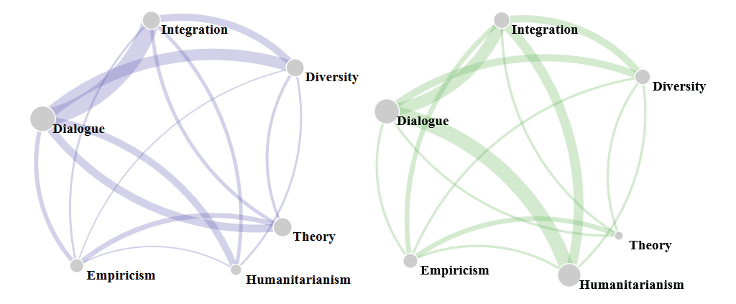
Thematic Links
Division One
APA Candidates

Slide 91
Themes: Constitutive Links
Theory
Empiricism:
Unity as
Homogeneity?
Integration
Dialogue
Diversity Appreciation
Humanitarianism

Slide 92
Themes: Constitutive Links
Theory
Founds
Informs
Integration
Founds
Informs
Dialogue
Founds
Informs
Diversity Appreciation
Founds
Informs
Humanitarianism?

Slide 93
Science & Human Values
Values Pervade Science
Dialogue: Social
Integration: Epistemic
Diversity Appreciation: Social
Theory: Epistemic
Humanitarianism: Social
Dialogue: Epistemic

Slide 94
Summary and Conclusions
Mixed methods research is on the rise and becoming a new scientific standard in psychology
Quantitative and qualitative goals and questions are different, involve distinct perspectives and methods
Quantitative knowledge is dependent on qualitative, not vice versa
Quantitative methods have been extensively developed and dominated psychology’s view of science
Historically qualitative methods have been used informally, but formal methods and methodologies are becoming available
Qualitative goals, questions and methods can now be formally integrated with quantitative research: Infinite possibilities

Slide 95
Indigenous Psychological Methods
Non-Western Rationalities, observations, practices

Slide 96
Linda Tuhiwai Smith Decolonizing Methodologies: Research & Indigenous Peoples
“The word itself,
‘research,’
is probably one
of the dirtiest words
in the indigenous world’s vocabulary.”
(Smith, L.T. (2012). Decolonizing Methodologies: Research and Indigenous Peoples, second edition. London: Zed Books.)

Slide 97
Virgilio Enriquez (1942-1994) Sikolohiyang Pilipino (Filipino psychology)

Slide 98
Rogalia Pe-Pua

Slide 99
Sikolohiyang Pilipino (Filipino psychology)
Virgilio Enriquez: Kapwa (shared identity, self-other unity)
Pakapa-kapa--A suppositionless approach in social scientific investigations: search for meaning (Santiago, 1977; Torres, 1982)
Abstention from prior theories and received methods
Original methods developed: Pakikipamuhay (living with) (Enriquez, 1994, p. 58)
Methodological norms: participant input, equal status/power, primacy of participant well-being, all procedures within cultural norms (including language), integration of multiple indigenous methods (Pe-Pua, 2006)
Universal potential: Used by Hawaiians, Koreans, Japanese, Australian migrant and ethnic communities, Chinese, Macedonians, Pacific Islanders, Koreans, Serbians, Croatians, Lebanese, South Americans, Portuguese (Pe-Pua, 2006, 122).

Slide 100
Export (Potential Universality)
“(T)he indigenous Filipino philosophy of science is more exacting than its Anglo-American counterpart … [and this] incorporates the demands of empirical validation from katatagan (‘replicability and reliability’), to katapatan (‘multiple operationism and validity’) but also requires patibay (‘certification’), patotoo (‘affirmability and attestability’) and patunay (‘authenticity’)” (Enriquez, 1994, p. 49).

Slide 101
Analysis of Sikolohiyang Pilipino 1977-2008 Clemente (2011)
276 articles in Philippine Journal of Psychology
2 Categories of articles on Filipinos
Non-Filipino Psychology (FP): 39% (85)
Quantitative methods: 73% (62)
Literature review & theoretical: 12% (10)
Qualitative methods: 3.5% (3)
Mixed methods: 11.8% (10)
Filipino Psychology:
Quantitative: 42.5% (57)
Qualitative: 27.6% (37)
Mixed methods: 12.7% (17)
Indigenized from without: 53% (71)
Indigenized from within: 47% (63)

Slide 102
Clemente’s (2008) Results Continued
Non-FP studies spanned all topical areas of Western psychology
I/O remained entirely in Western frameworks
70.1% (94) used non-elite populations, only 9% (12) used only university students
Large majority addressed social/national issues
2/3 of FP used indigenized theory
Only 12.7% (17)practiced methodological indigenization (87.3% [117] non-indigenous methods.

Slide 103
Thank You!

